Slide 1
VARIABLE DC POWER SUPPLY
GROUP MEMBERS
Hafiz Ahsan Sheraz
Danyal Irfan Butt

Slide 2
INTRODUCTION
It is a supply whose voltage can be adjusted according to our requirement .
RELATION WITH OUR COURSE
It is based on the concepts of mutual induction between 2 coils and basic principles of the transformer .
EXTRA CONCEPTS
Rectification using diodes
Voltage regulation

Slide 3
HARDWARE USED
Step down transformer (to step down the voltage)
4 Diodes (for full wave rectification)
Voltage regulator (consisting of a LM 2596 DC to DC buck converter module and a capacitor for filtering)
Potentiometer (for varying DC voltage)
Digital Voltmeter (for displaying the variable DC voltage)

Slide 4
Agenda/Methodology
Step Down Transformer
Bridge Rectifier
Capacitive filter
Buck Converter
On/OFF switch
Output
(DC)

Slide 5
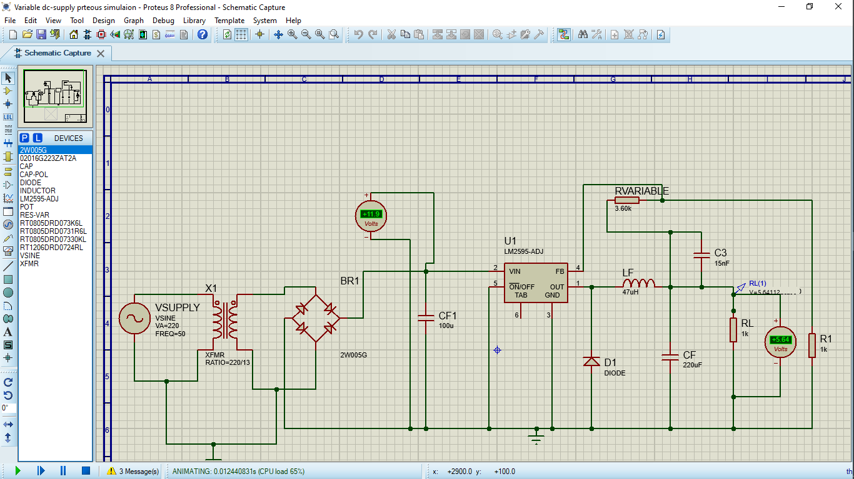
Schematics

Slide 6
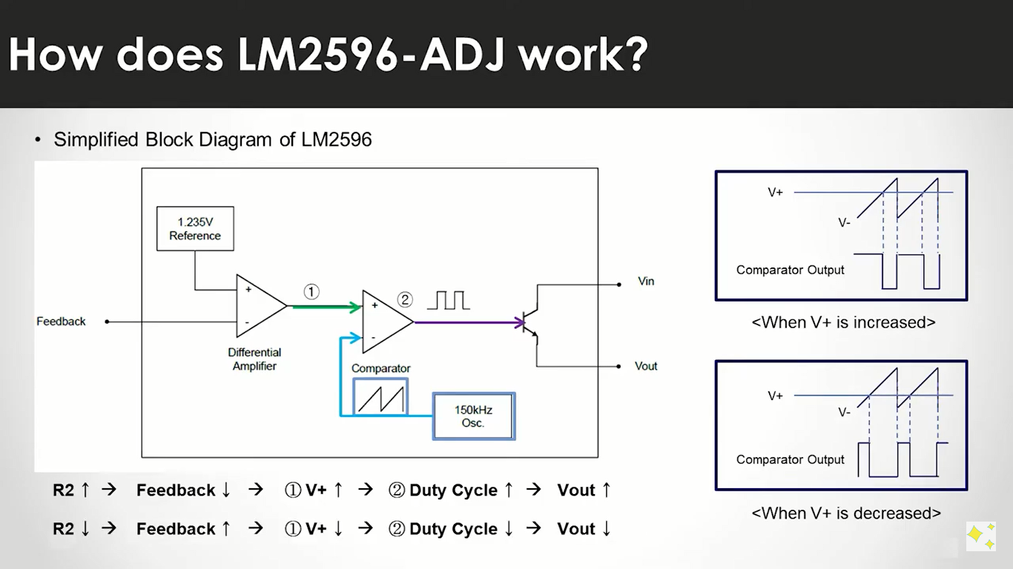
Lm2596 Module

Slide 7
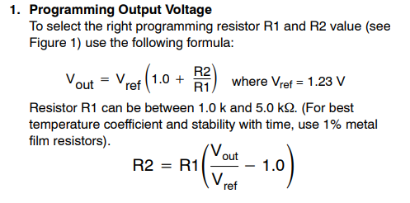
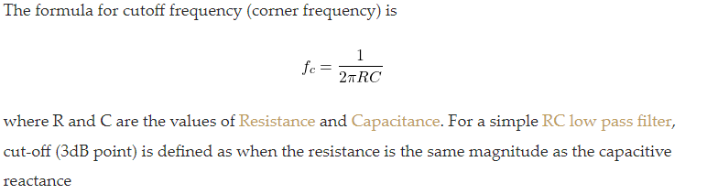
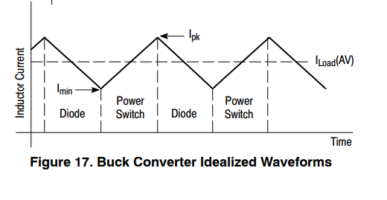
Formulas and Related Terms

Slide 8
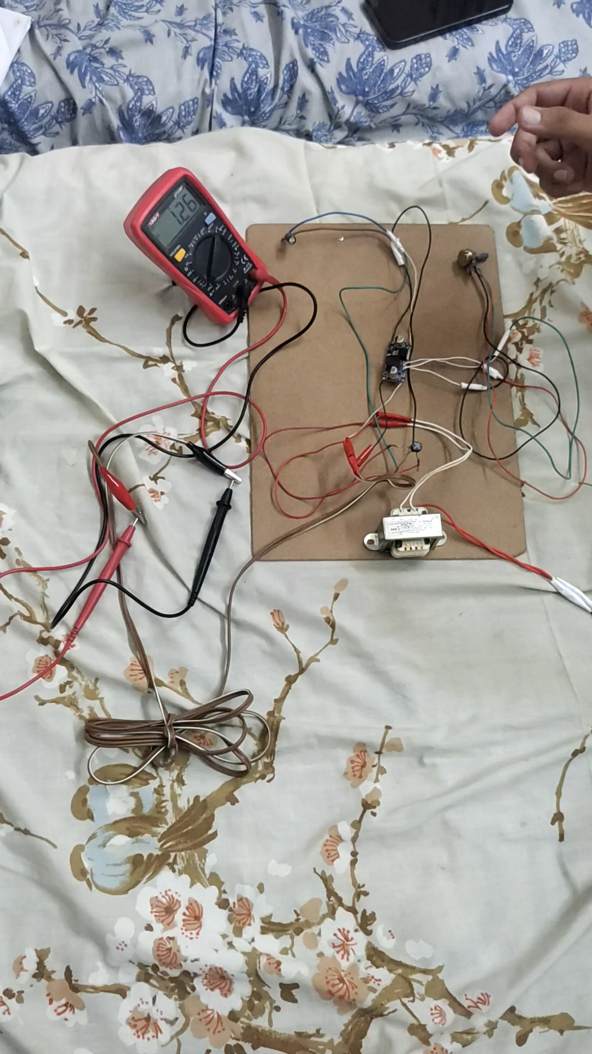

Slide 9
SHORTCOMINGS AND LIMITATIONS
Its voltage range is limited (voltage range depends on the transformer used) .
Current limit 3A due to buck converter (current will not exceed 3A).
Due to low power rating of transformer the circuit provides the maximum current of 0.48 Amps

Slide 10
IMPLICATIONS / APPLICATIONS
Voltage can be adjusted according to requirement .
Can be replaced by batteries of different voltage for operating small appliances .
Can be used for testing and analysis purposes of low voltage electronic circuits (for example to check minimum voltage at which a circuit operates).

